Slide 1
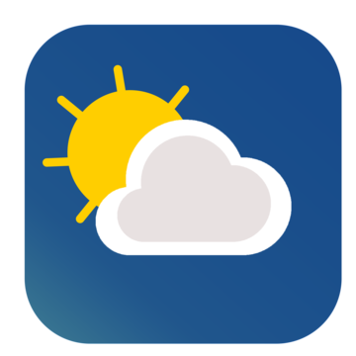
Internship Assessment Mini Project Presentation
Project: WEATHER APP
NAME : Nandini Sharma
SECTION: 3-B
ROLL NO.:2300290120145

Slide 2

INTRODUCTION
The Proposed system provides the weather of different cities around the World.
In this system the user can view Weather for which they search for.
The system can track Local and National Weather .
The Proposed system uses Open Weather App
API for searching the Weather.

Slide 3
THE PROBLEM STATEMENT
Lack of easily accessible, accurate, and real-time weather information.
Many apps are cluttered, slow, or provide outdated weather data.
Users need quick, reliable, and user-friendly interfaces.

Slide 4
SOLUTION TO ADDRESS THE PROBLEM
Build a simple, fast, and efficient weather app.
Key Features:
Real-time weather updates.
Displays current location and weather data.
Wind speed information along with temperature and humidity.
Simple and responsive user interface.
Reliable data from a trusted source (OpenWeatherMap API).

Slide 5




TECH STACK

Slide 6
METHODOLOGY
Planning: Define the features and scope of the app.
2. Designing: Create a user-friendly interface with Tailwind CSS.
3. Development: Use HTML, JavaScript to fetch and display weather data.
4. Integration: Connect with OpenWeatherMap API for real-time data.
5. Testing: Ensure that the app works efficiently across different devices and locations.
6. Deployment: Host the app online for public access.

Slide 7
BENEFITS
The weather app enables you make better prepration for the day in the relation to giving accurate daily weather.
We need Weather App to plan Journeys ahead, To plan meetings/ commute timings .
A person travelling in bus, train or flight may need to check the weather in his destination city.
The system provides you with details of the weather elements
- Temperature, wind speed ,Humidity, Wind Degrees, Pecipitation, etc.

Slide 8
WORKING OF THE PROJECT
Step 1: User inputs a city or uses location services.
Step 2: JavaScript sends a request to the OpenWeatherMap API.
Step 3: API returns real-time weather data.
Step 4: App displays weather info (temperature, humidity, etc.) on the interface.
Step 5: Responsive design ensures seamless experience on any device.

Slide 9
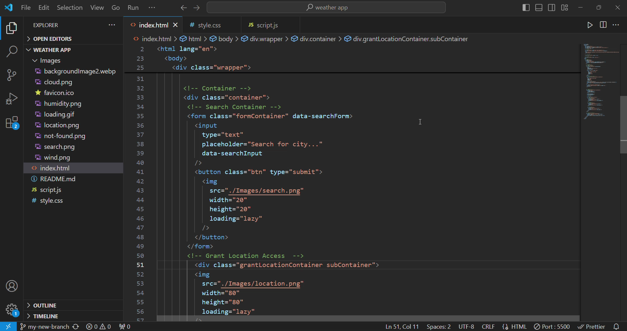

Slide 10
ARCHITECTURE DIAGRAM
User Device
Enter City Name
FRONTEND
Sending response
Back to User
Request for Weather
Open WeatheMapAPI
BACKEND
Current
Weather
Details

Slide 11
CONCLUSION
Weather App provides a seamless and intuitive solution for real-time weather tracking.
By utilizing the latest technology stack and OpenWeatherMap API, the app ensures users have access to accurate weather data, including temperature, humidity, wind speed, and more.
Whether at home or on the go, users can check the weather for their current location or any city worldwide.
The app’s simple interface and fast performance make it an essential tool for daily planning, ensuring users stay informed and prepared for any weather condition.

Slide 12
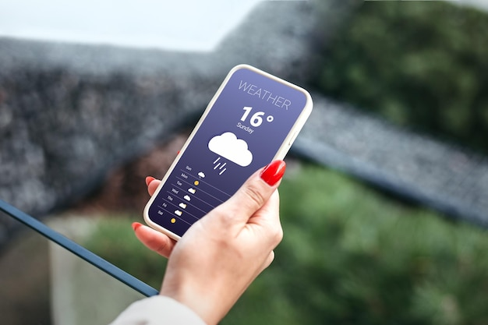
Thank you!

